Slide 2
World Missions at Dwell
The Mission
The Vision
The Strategy
Our Global Partners

Slide 3
1. The Mission
Category | % of World Population
Christians-Majority People Groups | 33%
Culturally-Near Non-Believers¹ | 27%
Unreached People Groups | 40%
Frontier People Groups² | 25%
¹able to be reached by Christians in their own people groups
²1.9 billion people on planet earth who have no gospel presence (< 0.1%)
**72% of FPGs live in South Asia
Source: R. W. Lewis – Clarifying the Remaining Frontier Mission Task from WCD

Slide 4
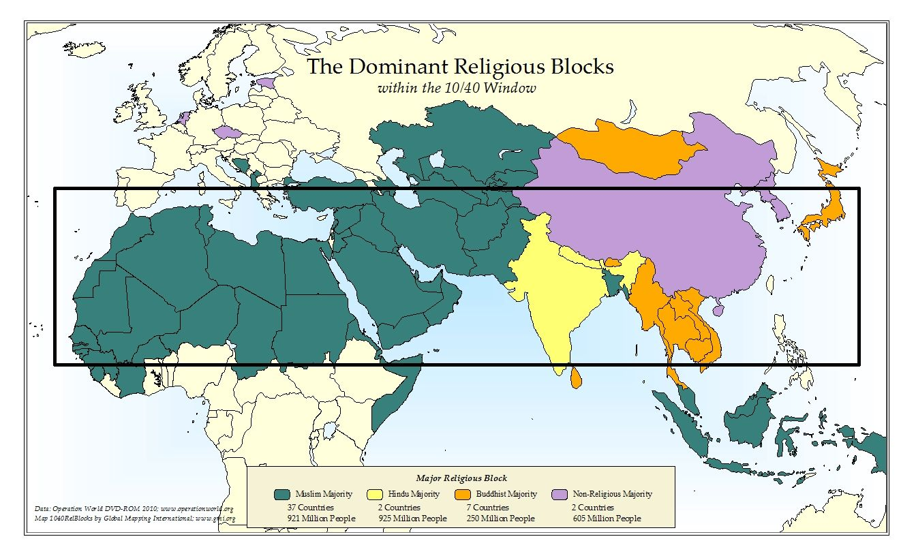
God is raising up indigenous and near-neighbor workers to finish the mission!

Slide 5
2. The Vision
Global Partners

Slide 6
3. The Strategy

Slide 7
Indigenous Core
On-Site or Off-Site
Catalyst
Mobilization
Movement
Watch/Care

Slide 8
3. The Strategy
Principles for sending:
Dwell is committed to sending workers overseas
Sent & overseen by the local church
Assisted by the missions agency
Character and competence qualifications
Compatibility-based system:
Global Partner, Strategic Partner, Support Role

Slide 9
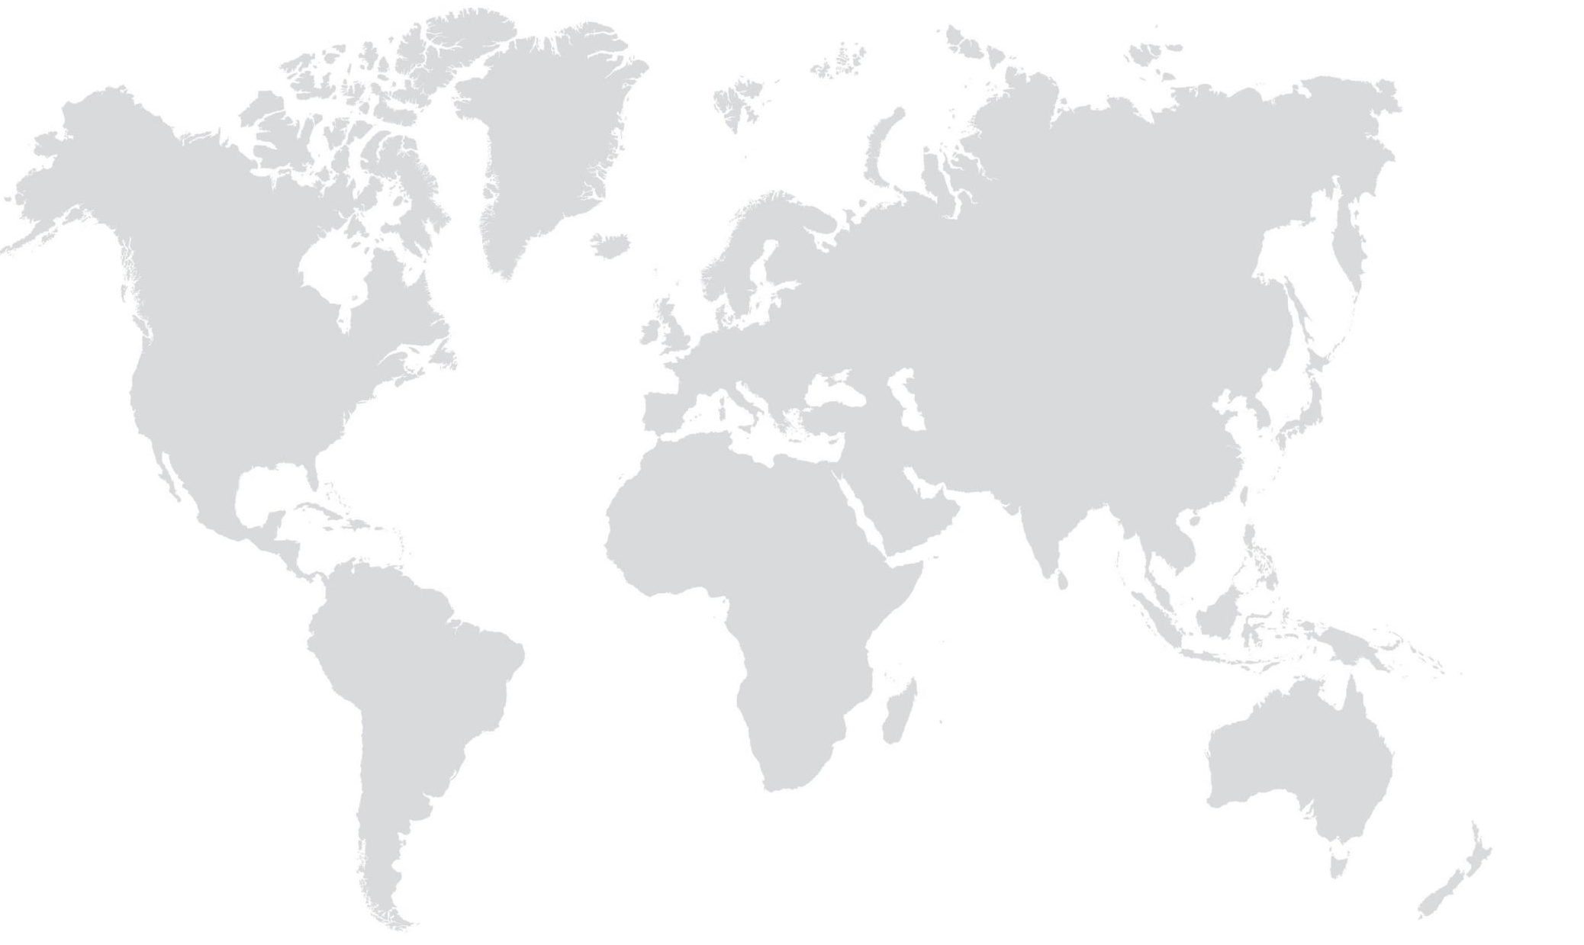
4. Our Global Partners
FOUNTAIN OF HOPE
CENTRAL ASIA
MERCY MEDICAL
HAITI
ETHIOPIA
FRIENDSHIP SCHOOL
WEST AFRICA
INDIA GOSPEL LEAGUE
ECUADOR
DRC
SOUTHEAST ASIA

Slide 10
House Churches
Attendance
Leaders
5,437
47,430
3,722
13 Global Workers
415 Indigenous Workers
*as of Q1 2024
+33.8%
+3.6%

Slide 11
House Churches
Attendance
Leaders
5,437
47,430
3,722
*as of Q1 2024
+28.8%
+2.9%

Slide 12
House Churches
Attendance
Leaders
5,437
47,430
3,722
*as of Q1 2024
+53.8%
+3.6%

Slide 13
4. Our Global Partners
Play your part!
Pray: advocacy teams, missions nights
Learn: living room talks, short-term trips, resources
Give: Global Partnership Fund, Global Workers

Slide 14
World Missions at Dwell
The Mission
The Vision
The Strategy
Our Global Partners
Questions?
Comments?
missionsadmin@dwellcc.org

