Slide 1
Flexibility in Parenting

Slide 2
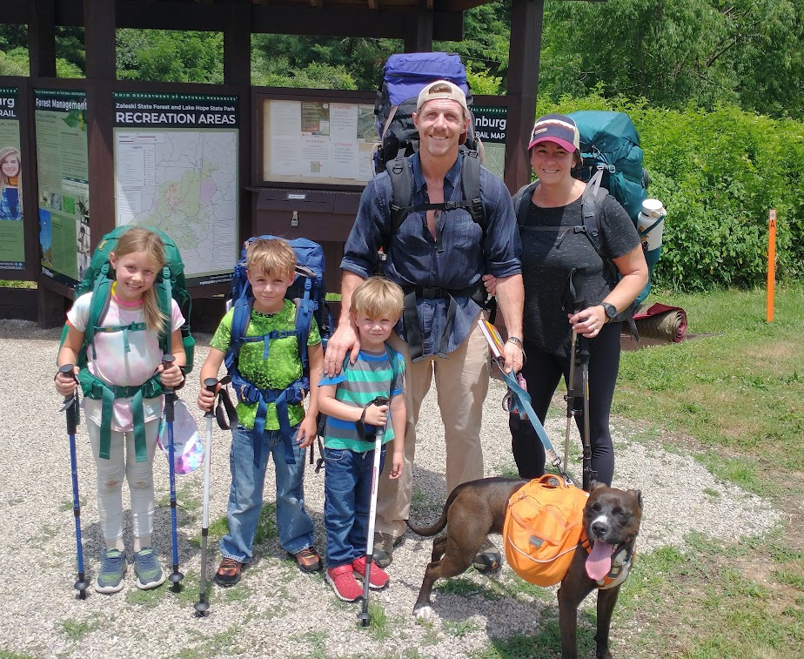
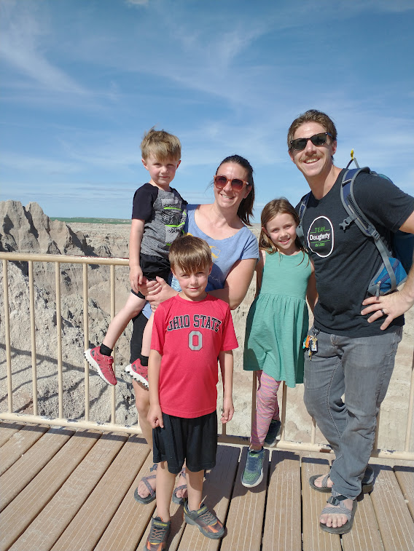

Slide 3
The Problem
Black and White Thinking in Parenting

Slide 4
The Problem
Mom shaming

Slide 5
The Problem
Mom shaming
Internal shaming

Slide 6
The Problem
Mom shaming
Internal shaming
X + Y = expected outcome

Slide 7
The Problem
Mom shaming
Internal shaming
X + Y = expected outcome
Comparing ourselves to others

Slide 8
We are unique
Psalm 139: 13-16
13 For you created my inmost being; you knit me together in my mother’s womb.
14 I praise you because I am fearfully and wonderfully made; your works are wonderful, I know that full well.

Slide 9
We are unique
15 My frame was not hidden from you when I was made in the secret place, when I was woven together in the depths of the earth.
16 Your eyes saw my unformed body; all the days ordained for me were written in your book before one of them came to be.

Slide 10
We are unique
Ephesians 2:10
For we are God’s handiwork, created in Christ Jesus to do good works, which God prepared in advance for us to do.

Slide 11
We are unique
Heb. 10:24: And let us consider how we may spur one another on toward love and good deeds

Slide 12
“Most of the parents we have interviewed in the general population acknowledged that their kids are different, but believe that their parenting behavior toward each child must be nearly identical to be fair. Revolutionary Parents don’t buy that line of reasoning.

Slide 13
They have operated on principle- very successfully- that because each of their youngsters is unique, their parenting responses must be unique as well. Yes, there are a few golden principles that they adhere to in disciplining and educating each child.

Slide 14
For instance, they may believe that showing compassion to their children is necessary, but what constitutes compassion for one child (such as allowing a normally diligent child to miss school for a minor ailment) might be detrimental to another child (reinforcing a lackadaisical child’s manipulative tendency).

Slide 15
Each one of us has a unique blend of personality types, spiritual gifts, natural talents, dreams, and limitations that can be maximized if we understand that mixture and try to draw out the strengths and not worry about the areas that are not strong.

Slide 16
96% of the Revolutionary Parents we interviewed took the time and made the effort to learn the unique nature of each of their children and to build a parenting framework around each child’s distinctives.”

Slide 17
Questions to Think Through
How does your child feel loved?
How does your child show love?
What does your child find motivating?
What frustrates your child?
How does your child express their emotions?
How does your child react when things go wrong or when they make a mistake?
What are your child’s strengths?
What are their weaknesses?

Slide 18
Different Ages
1 Corinthians 13:11
When I was a child, I talked like a child, I thought like a child, I reasoned like a child. When I became a man, I put the ways of childhood behind me.

Slide 19
Different Ages
Matthew 9:17
Neither do people pour new wine into old wineskins. If they do, the skins will burst; the wine will run out and the wineskins will be ruined. No, they pour new wine into new wineskins, and both are preserved.

Slide 20
The Bible Gives Us Direction
Cindi Botti’s teaching- Our vision for parenting
Raising Spiritual Champions

Slide 21
My job as a parent is to raise my child to be:
Safe
Secure
Successful
Happy
A good kid
Comfortable

Slide 22
“Most people today rarely step outside their comfort zones. We are living progressively sheltered, sterile, temperature-controlled, overfed, underchallenged, safety-netted lives. And it’s limiting the degree to which we experience our “one wild and precious life” as poet Mary Oliver put it.

Slide 23
But a radical new body of evidence shows that people are at their best- physically harder, mentally tougher, and spiritually sounder- after experiencing the same discomforts our early ancestors were exposed to every day.

Slide 24
Scientists are finding that certain discomforts protect us from physical and psychological problems like obesity, heart disease, cancers, diabetes, depression, and anxiety, and even fundamental issues like feeling a lack of meaning and purpose.”

Slide 25
The Bible Gives Us Direction
Colossians 1:28
He is the one we proclaim, admonishing and teaching everyone with all wisdom, so that we may present everyone fully mature in Christ.

Slide 26
The Bible Gives Us Direction
Respecting Authority

Slide 27
Respecting Authority
Ephesians 6: 1-3
1 Children, obey your parents in the Lord, for this is right. 2 “Honor your father and mother”—which is the first commandment with a promise— 3 “so that it may go well with you and that you may enjoy long life on the earth.”

Slide 28
Respecting Authority
1 Samuel 15:22
But Samuel replied:
“Does the Lord delight in burnt offerings and sacrifices as much as in obeying the Lord?
To obey is better than sacrifice,
and to heed is better than the fat of rams.”

Slide 29
Respecting Authority
James 1:22
Do not merely listen to the word, and so deceive yourselves. Do what it says.

Slide 30
The Bible Gives Us Direction
Respecting Authority
Discipline

Slide 31
Discipline
the practice of training people to obey rules or a code of behavior

Slide 32
Discipline
Ephesians 6:4
Fathers, do not exasperate your children; instead, bring them up in the training and instruction of the Lord.

Slide 33
Discipline
Heb. 12:7-11
7 Endure hardship as discipline; God is treating you as his children. For what children are not disciplined by their father? 8 If you are not disciplined—and everyone undergoes discipline—then you are not legitimate, not true sons and daughters at all. 9 Moreover, we have all had human fathers who disciplined us and we respected them for it.

Slide 34
Discipline
How much more should we submit to the Father of spirits and live! 10 They disciplined us for a little while as they thought best; but God disciplines us for our good, in order that we may share in his holiness. 11 No discipline seems pleasant at the time, but painful. Later on, however, it produces a harvest of righteousness and peace for those who have been trained by it.

Slide 35
The Bible Gives Us Direction
Respecting Authority
Discipline
Respecting/Loving Others

Slide 36
Respecting and Loving Others
1 John 4:9-11
9 This is how God showed his love among us: He sent his one and only Son into the world that we might live through him. 10 This is love: not that we loved God, but that he loved us and sent his Son as an atoning sacrifice for our sins. 11 Dear friends, since God so loved us, we also ought to love one another.

Slide 37
The Bible Gives Us Direction
Respecting Authority
Discipline
Respecting/Loving Others
Thinking Critically/Making Own Decisions

Slide 38
Thinking Critically
Isaiah 1:18
Come now, and let us reason together..

Slide 39
Thinking Critically
Proverbs 14:15
The simple believe anything,
but the prudent give thought to their steps.

Slide 40
Encourage your children to engage in a lot of “productive disagreement.” As psychologist Adam Grant notes, the most creative people grew up in homes full of arguments, yet few parents today teach their children how to argue productively; instead, “we stop siblings from quarreling and we have our own arguments behind closed doors.”

Slide 41
But learning how to give and take criticism without being hurt is an essential life skill. When serious thinkers respect someone, they are willing to engage them in a thoughtful argument.

Slide 42
The Bible Gives Us Direction
Respecting Authority
Discipline
Respecting/Loving Others
Thinking Critically/Making Own Decisions
Resiliency

Slide 43
Resiliency
2Timothy 1:7
For the Spirit God gave us does not make us timid, but gives us power, love and self-discipline.

Slide 44
Resiliency
Philippians 4:13
I can do all this through him who gives me strength.

Slide 45
Resiliency
2 Corinthians 4:8, 9
8 We are hard pressed on every side, but not crushed; perplexed, but not in despair; 9 persecuted, but not abandoned; struck down, but not destroyed.

Slide 46
Children, like many other complex adaptive systems, are antifragile. Their brains require a wide range of inputs from their environments in order to configure themselves for those environments. Like the immune system, children must be exposed to challenges and stressors (within limits, and in age-appropriate ways),

Slide 47
or they will fail to mature into strong and capable adults, able to engage productively with people and ideas that challenge their beliefs and moral convictions.

Slide 48
The Bible Gives Us Direction
Respecting Authority
Discipline
Respecting/Loving Others
Thinking Critically/Making Own Decisions
Resiliency
Routines

Slide 49
Routine
1Corinthians 14:33a
For God is not a God of disorder but of peace

Slide 50
The Bible Gives Us Direction
Respecting Authority
Discipline
Respecting/Loving Others
Thinking Critically/Making Own Decisions
Resiliency
Routines
Community

Slide 51
The Bible Gives Us Direction
Respecting Authority Family Time
Discipline
Loving Others
Thinking Critically
Resiliency
Routines
Community

Slide 52
Family Time
Psalm 127:3
Behold, children are a gift of the Lord,
The fruit of the womb is a reward.

Slide 53
Assess
Is there an area I can focus on in my parenting right now that connects all or some of these?
Is there one issue that comes up often?
Is there a pattern?
Are there areas that can wait?
What have I tried already in this area, and what haven’t I tried yet?

Slide 54
Feedback
Do you share with your partner weaknesses and strengths that you see in their parenting?
Do you ask them for their input into your weaknesses and strengths?
Do you periodically discuss with your partner your children’s growth and personality, and how you can be most effective?

Slide 55
Feedback
We need to be willing to take feedback in our parenting
We need to be willing to give feedback into our friends’ parenting as well

