Slide 1
Raising Spiritual Servants

Slide 2
Background
Upbringing
Job
Gifting

Slide 3
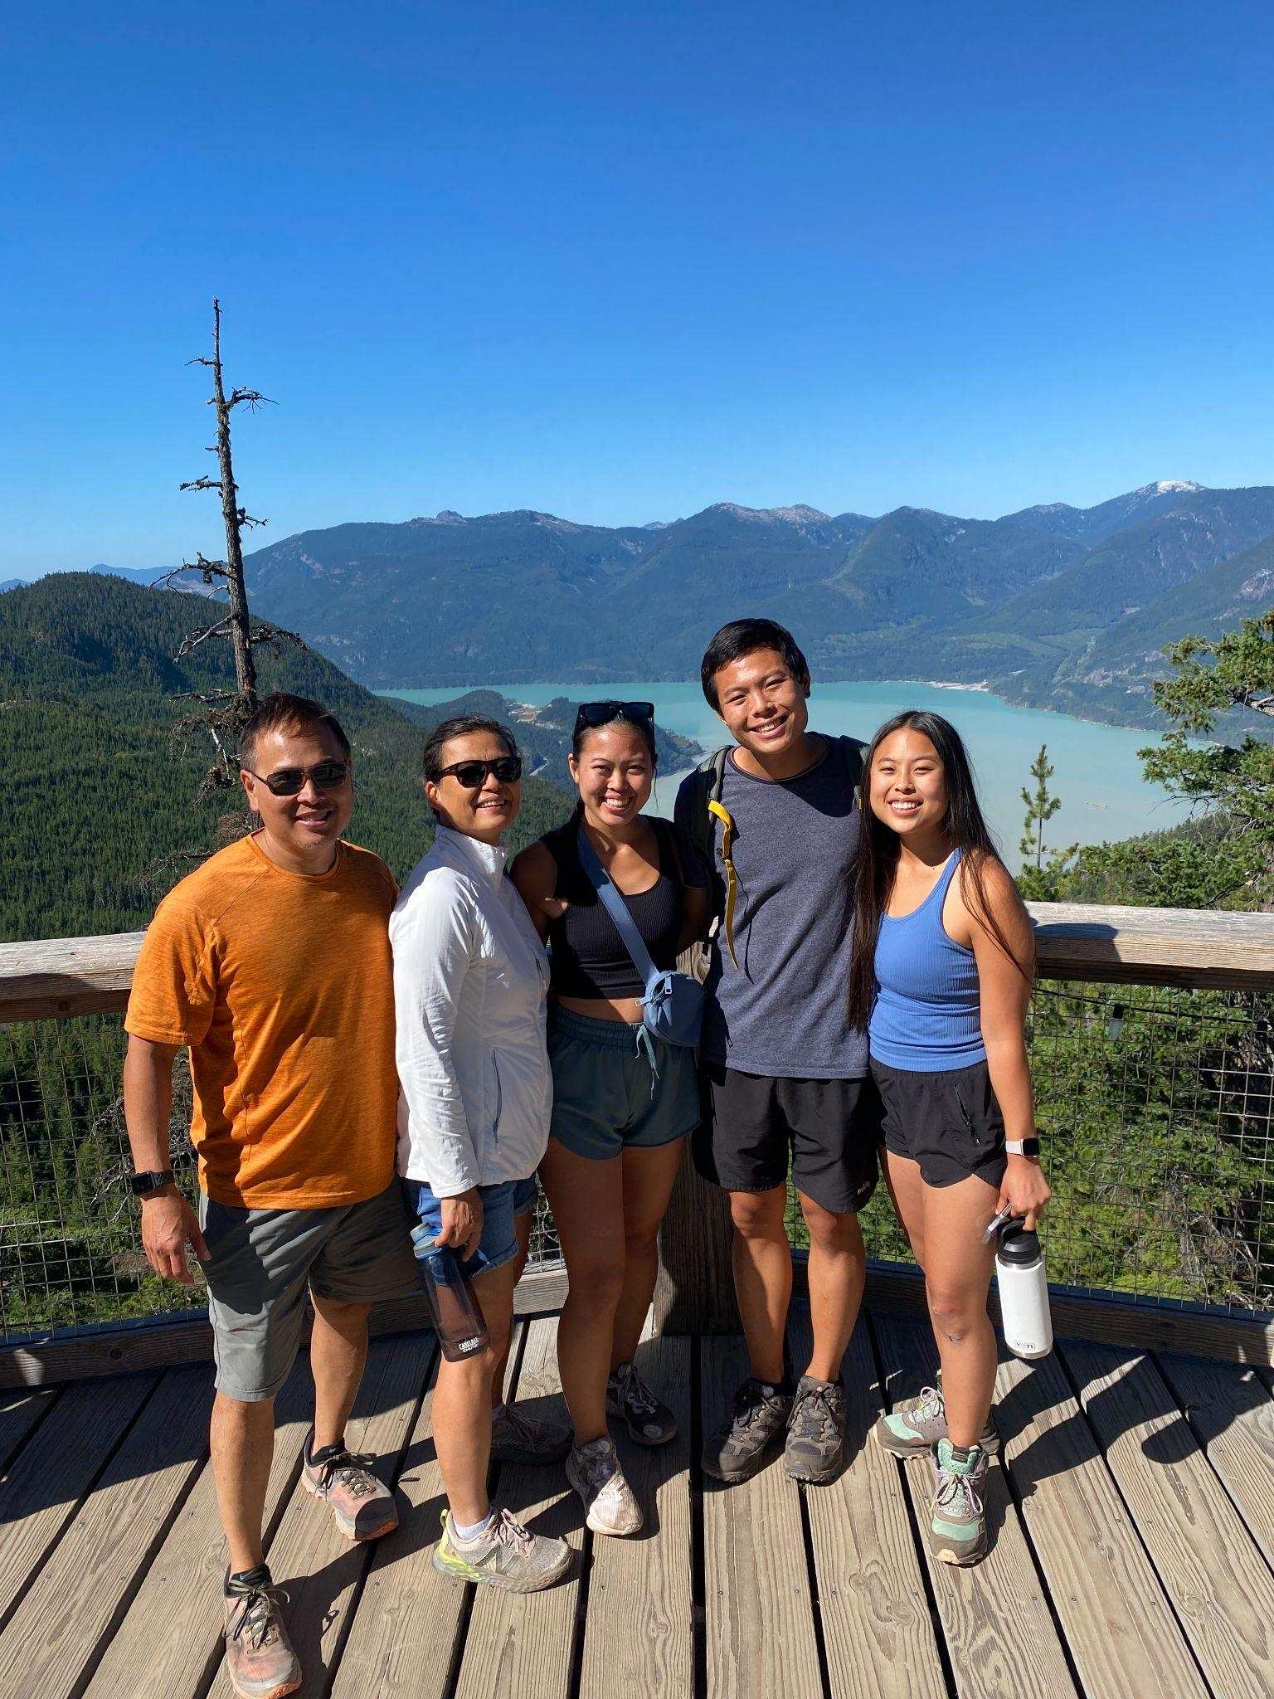

Slide 4
Foundation
Christ’s Example
Have this attitude in yourselves which was also in Christ Jesus, who, although He existed in the form of God, did not regard equality with God a thing to be grasped, but emptied Himself, taking the form of a bond-servant, and being made in the likeness of men. Being found in appearance as a man, He humbled Himself by becoming obedient to the point of death, even death on a cross. Phil 2:5-8

Slide 5
Mk 10:45 Son of man didn’t come to be served but to serve
1 Pet 2:16 Do not use your freedom for self instead use to serve one another
1 Peter 4:10 As each received a gift, use to serve one another
Acts 20:35 More blessed to give than to receive
Heb 13:16 Do not neglect in sharing and doing good

Slide 6
Motivation:
God’s Grace
1 Cor 10:31 basis of actions should be for the glory of God
Mt 6:1 “Beware of practicing your righteousness before men to be noticed by them”
Col 3:17 “Whatever you do in word or deed, do all in the name of Lord Jesus
Lifestyle not a behavior

Slide 7
Servanthood
Bondservant
Countercultural
Paul & Timothy - Philippians
Peter & John - Acts
Believers - Revelations
Counterintuitive
"I am a slave to the Lord Jesus Christ. I am absolutely sold out to His will. I am willing to do whatever He tells me to do. I am willing to say whatever He tells me to say. I am willing to go wherever He leads me. I am a man who has made a choice. I am going to serve Him for all eternity."

Slide 8
Principles:
We need to first own this for ourselves.
Model & teach this to our kids:
Teach them to think how can they serve: motives, perseverance
Teach them how to serve in the family so they can serve outside family
Serve with our kids
Debrief with them

Slide 9
Examples of Ways to Serve
Toddler
Junior High
Prepare meals
Laundry
Yard work - mow lawn
Backyard Bible Club
Babysit
Greet Daddy
Throw away diaper
Help set table
Clean up
Pray
Elementary
Teenagers
Make lunch
Help with laundry
Set & clear table
Help with groceries
Writing notes
Make meals/treats
Babysit
Give rides
Volunteer in Community - VBS, Oasis

Slide 10
Barriers:
Impatience
Busyness
Compartmentalizing
Enabling

Slide 11
Benefits:
Joy of service - part of something bigger than themselves
Mental, physical & spiritual health

Slide 12
“Kids can only go on for so long, feeling such painful empathy without any opportunity to do anything about it, before they begin to tell themselves to stop feeling anything at all.”
She suggests pointing them toward altruism before they become hardened, because serving others “helps kids discover their talents, hone their skills and begin to believe in themselves.” Deborah Spaide, Teaching Your Kids to Care: How to Discover and Develop the Spirit of Charity in Your Children

Slide 13
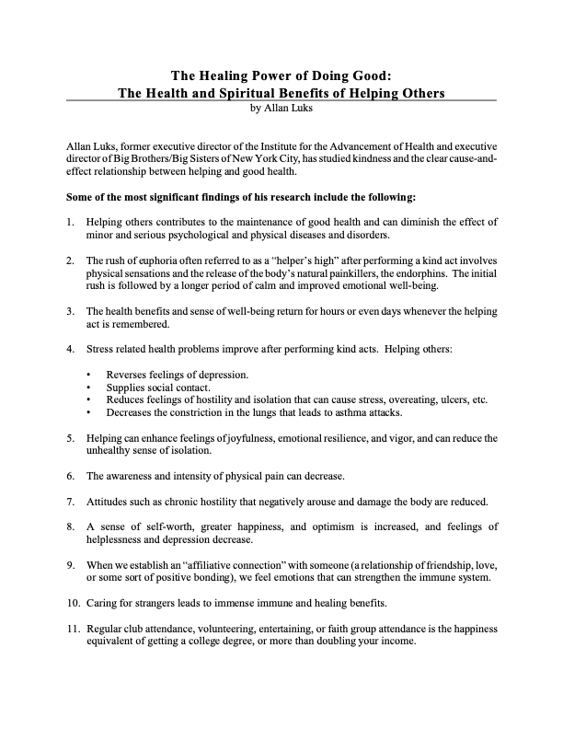

Slide 14
The Benefits Of Volunteerism
Naturally, the dialogue surrounding activism and volunteerism centers on how others will benefit from volunteer work that you do. But years of research demonstrate that there are benefits for volunteers themselves. Whether you are a family member or caregiver for someone with a mental health condition — or have the lived experience yourself — volunteering can be a positive step toward improving your health and yield many benefits:
Reducing Stress My work with NAMI demonstrates the ways in which volunteering can counteract the effects of stress, anger and anxiety. This kind of work was my first exploration into long-term volunteerism — and, as is my nature, I sometimes felt a little anxious as I prepared to lead an affiliate board meeting or teach or speak to a group on behalf of NAMI. But I always rose to the occasion because the cause mattered so greatly to me. And afterward, I would feel exhilarated and thrilled by my accomplishments. Gradually, my focus on the work, and the gratitude I received from it, surpassed other issues in my life that caused negative emotions. There was too much to accomplish and too much to look forward to for me to feel down. Ultimately, I noticed that I slept better at night with the knowledge that I was part of a greater good.
Increasing Happiness Research has found a correlation between volunteering and happiness. A 2020 study conducted in the United Kingdom found those who volunteered reported being more satisfied with their lives and rated their overall health as better. Respondents who volunteered for at least one month also reported having better mental health than those who did not volunteer.
FEB. 02, 2022
By Trish Lockard

Slide 15
Developing Confidence Volunteering is an opportunity to develop confidence and self-esteem. Your role as a volunteer can also give you a sense of pride and identity, something that can be hard to come by for people with a mental health diagnosis. The better you feel about yourself, the more likely you are to have a positive view of your life and future. Moreover, I’ve found that the sense of accomplishment from serving others can raise self-esteem and self-confidence.
Finding Purpose In times when you feel lost, volunteering can give you a sense of purpose. Dedicating time to a cause can give you new direction and allow you to find meaning in something unexpected. It can also take your mind off your own troubles while keeping you mentally stimulated.

Slide 16
Summary:
It really is more blessed to give than receive
Process - becoming who we are in Christ
Each Family unique

Slide 17
Resources
Parentingtoimpress.com How to Raise Children who serve
Healing Power of Doing Good Allan Luks with Peggy Payne
Teaching Your Kids to Care: How to Discover and Develop the Spirit of Charity in Your Children Deborah Spaide
Manipulative Child Ernest W. Swihart Jr and Patrick Cotter

