Slide 1
Hebrews 5&7
Jesus a New and Better High Priest

Slide 2
Hebrews so far
Jewish background Christians under pressure
Chapters 1&2 The Supremacy of Christ
Chapters 3&4 Entering God’s rest

Slide 3
Chapters 5-10
The Supremacy of the New Covenant
The consistency of God’s plan from OT to NT
How do they fit together?

Slide 4
Hebrews 4:14–16 (NASB95)
14 Therefore, since we have a great high priest who has passed through the heavens, Jesus the Son of God, let us hold fast our confession. 15 For we do not have a high priest who cannot sympathize with our weaknesses, but One who has been tempted in all things as we are, yet without sin. 16 Therefore let us draw near with confidence to the throne of grace, so that we may receive mercy and find grace to help in time of need.

Slide 5
Hebrews 4:14–16 (NASB95)
14 Therefore, since we have a great high priest who has passed through the heavens, Jesus the Son of God, let us hold fast our confession. 15 For we do not have a high priest who cannot sympathize with our weaknesses, but One who has been tempted in all things as we are, yet without sin. 16 Therefore let us draw near with confidence to the throne of grace, so that we may receive mercy and find grace to help in time of need.
What is a High Priest?

Slide 6
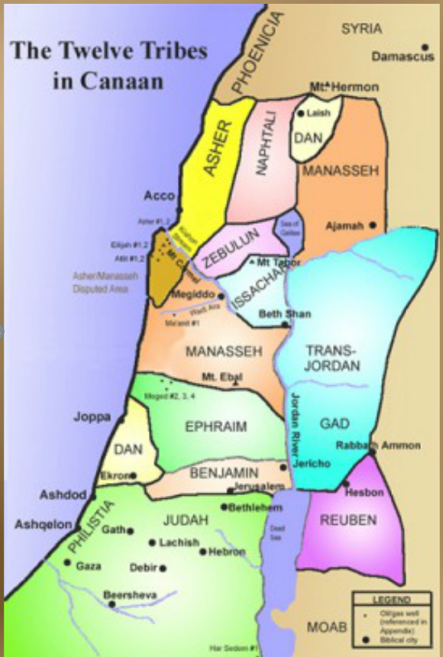
Jewish History
Genesis 49:10 (NASB95) — 10 “The scepter shall not depart from Judah, Nor the ruler’s staff from between his feet, Until Shiloh comes, And to him shall be the obedience of the peoples.

Slide 7
Jewish History
Numbers 3:6–8 (NASB95) — 6 “Bring the tribe of Levi near and set them before Aaron the priest, that they may serve him. 7 “They shall perform the duties for him and for the whole congregation before the tent of meeting, to do the service of the tabernacle. 8 “They shall also keep all the furnishings of the tent of meeting, along with the duties of the sons of Israel, to do the service of the tabernacle.

Slide 8
Priest
Someone to go to God for the people
An intermediary

Slide 9
So what is a “High Priest”?
Chosen among the priests
Represent all of Israel
Play an important role in the sacrificial system

Slide 10
Hebrews 5:1–3 (NASB95)
1 For every high priest taken from among men is appointed on behalf of men in things pertaining to God, in order to offer both gifts and sacrifices for sins; 2 he can deal gently with the ignorant and misguided, since he himself also is beset with weakness; 3 and because of it he is obligated to offer sacrifices for sins, as for the people, so also for himself.

Slide 11
Hebrews 5:4–6 (NASB95)
4 And no one takes the honor to himself, but receives it when he is called by God, even as Aaron was. 5 So also Christ did not glorify Himself so as to become a high priest, but He who said to Him, “You are My Son, Today I have begotten You”; 6 just as He says also in another passage, “You are a priest forever According to the order of Melchizedek.”

Slide 12
So what is a “High Priest”?
Jesus
Is our new and permanent High priest
Not a Levite
From the tribe of Judah
1) A Levite
2) Carries out the Temple Sacrifice
3) Represents the people to God

Slide 13
Hebrew Law
All priests descended from Levi
All Kings descended from Judah
There could be NO King/Priest

Slide 14
Psalm 110:1–4 (NASB95)
1 The Lord says to my Lord: “Sit at My right hand Until I make Your enemies a footstool for Your feet.” 2 The Lord will stretch forth Your strong scepter from Zion, saying, “Rule in the midst of Your enemies.” 3 Your people will volunteer freely in the day of Your power; In holy array, from the womb of the dawn, Your youth are to You as the dew. 4 The Lord has sworn and will not change His mind, “You are a priest forever According to the order of Melchizedek.”

Slide 15
Hebrew Law
You can’t be from two tribes
Yet the Messiah would be King/Priest
The importance of internal consistency of scripture
Especially important to a Hebrew audience

Slide 16
The Ramifications
Melchizedek
Either there is a way to explain this
The Old Testament and New testament contradict
One or both of them are wrong

Slide 17
Genesis 14:17–20 (NASB95) —
17 Then after his return from the defeat of Chedorlaomer and the kings who were with him, the king of Sodom went out to meet him at the valley of Shaveh (that is, the King’s Valley). 18 And Melchizedek king of Salem brought out bread and wine; now he was a priest of God Most High. 19 He blessed him and said, “Blessed be Abram of God Most High, Possessor of heaven and earth; 20 And blessed be God Most High, Who has delivered your enemies into your hand.” He gave him a tenth of all.

Slide 18
Who is Melchizedek
And where does he come from?
500 years

Slide 19
Hebrews 7:1–2 (NASB95)
1 For this Melchizedek, king of Salem, priest of the Most High God, who met Abraham as he was returning from the slaughter of the kings and blessed him, 2 to whom also Abraham apportioned a tenth part of all the spoils, was first of all, by the translation of his name, king of righteousness, and then also king of Salem, which is king of peace.

Slide 20
Melchizedek
Shows up out of nowhere
Name means “King of Peace/righteousness”
Abraham bows down to him

Slide 21
Hebrews 7:3–7 (NASB95)
3 Without father, without mother, without genealogy, having neither beginning of days nor end of life, but made like the Son of God, he remains a priest perpetually. 4 Now observe how great this man was to whom Abraham, the patriarch, gave a tenth of the choicest spoils. 5 And those indeed of the sons of Levi who receive the priest’s office have commandment in the Law to collect a tenth from the people, that is, from their brethren, although these are descended from Abraham.

Slide 22
Hebrews 7:3–7 (NASB95)
6 But the one whose genealogy is not traced from them collected a tenth from Abraham and blessed the one who had the promises. 7 But without any dispute the lesser is blessed by the greater.

Slide 23
The Author’s point
There was a priesthood before Levi
Levi came from Abraham’s line
Abraham was not as great as Melchizedek
Melchizedek was a priest.
Melchizedek’s priesthood was older and greater than Levi’s priesthood

Slide 24
The Author’s point
Ps 110 The Messiah would be a priest King
From the line of Judah in the order of Melchizedek
Jesus is a superior priest from a superior priesthood

Slide 25
Hebrews 7:11–12 (NASB95)
11 Now if perfection was through the Levitical priesthood (for on the basis of it the people received the Law), what further need was there for another priest to arise according to the order of Melchizedek, and not be designated according to the order of Aaron? 12 For when the priesthood is changed, of necessity there takes place a change of law also.

Slide 26
A New Priest and a New Covenant
The Old Covenant worked through human priests
The New Covenant only has one priest
The Old was always temporary
Ps 110 predicts a new a greater priesthood
The Melchizedek priesthood is permanent. God’s eternal plan for how we should relate to Him!

Slide 27
Hebrews 7:23–25 (NASB95)
23 The former priests, on the one hand, existed in greater numbers because they were prevented by death from continuing, 24 but Jesus, on the other hand, because He continues forever, holds His priesthood permanently. 25 Therefore He is able also to save forever those who draw near to God through Him, since He always lives to make intercession for them.

Slide 28
Hebrews 7:23–25 (NASB95)
23 The former priests, on the one hand, existed in greater numbers because they were prevented by death from continuing, 24 but Jesus, on the other hand, because He continues forever, holds His priesthood permanently. 25 Therefore He is able also to save forever those who draw near to God through Him, since He always lives to make intercession for them.
We need an intercessor

Slide 29
Isaiah 59:1–2 (NASB95) —
1 Behold, the Lord’s hand is not so short That it cannot save; Nor is His ear so dull That it cannot hear. 2 But your iniquities have made a separation between you and your God, And your sins have hidden His face from you so that He does not hear.

Slide 30
1 Timothy 2:3–6 (NASB95)
3 This is good and acceptable in the sight of God our Savior, 4 who desires all men to be saved and to come to the knowledge of the truth. 5 For there is one God, and one mediator also between God and men, the man Christ Jesus, 6 who gave Himself as a ransom for all, the testimony given at the proper time.

Slide 31
How to deal with God
Ignore Him
He will not ignore us
Try to impress Him with your good deeds
The standard is perfection!
Good deeds don’t wipe out bad deeds
Go to a human intercessor
They are just as flawed as we are

Slide 32
How to deal with God
Accept Jesus as your intercessor

Slide 33
The Reliability of Scripture
Scripture is consistent with itself
It takes pieces written by 40 different authors over 1500 years, and knits them together perfectly.
There is great evidence here of a great mind that spans generations of human witnesses

Slide 34
Pastors are not intermediaries
They should not be put on pedestals
They are shepherds and servants
They do not have more pull with God
At best they should serve as examples of what everyone can do.

