Slide 1
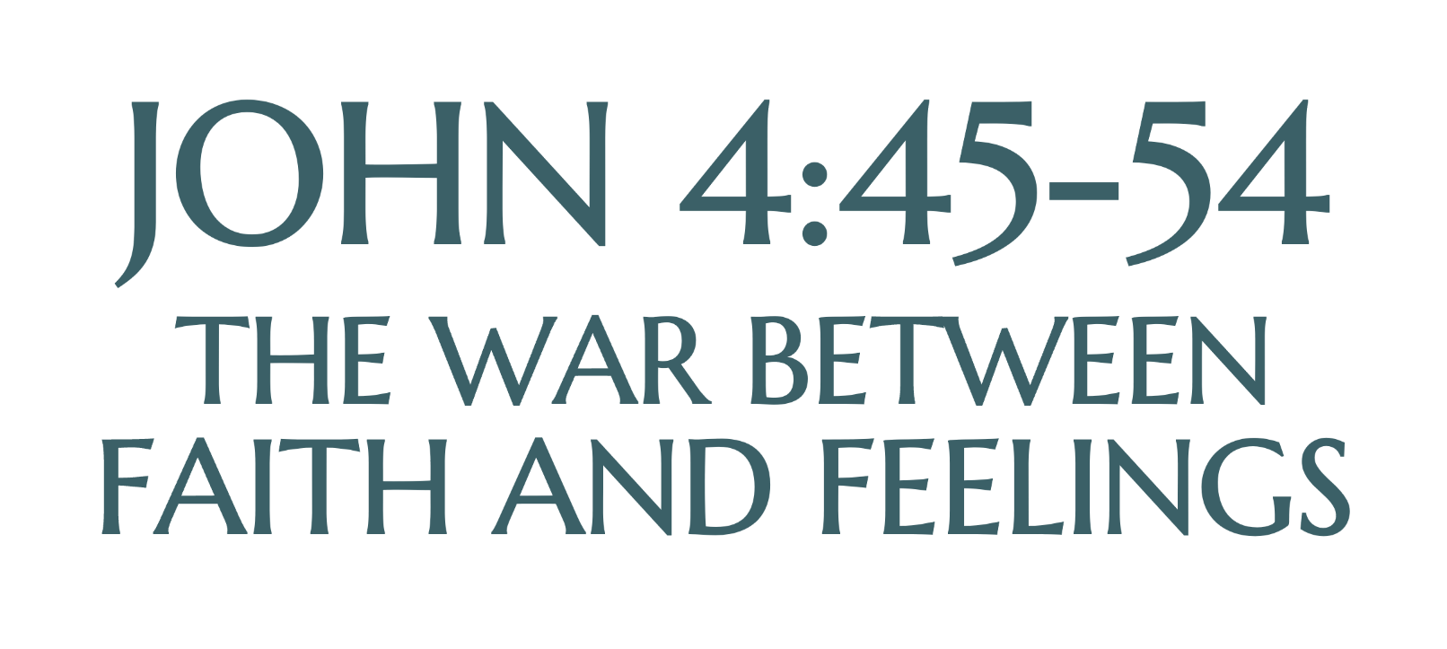

Slide 2
(Jn. 4:45) When Jesus arrived in Galilee, the Galileans welcomed him.
They had seen all that he had done in Jerusalem at the Passover Festival, for they also had been there.

Slide 3
(Jn. 4:46) Once more Jesus visited Cana in Galilee, where he had turned the water into wine.

Slide 4
(Jn. 4:46) And there was a certain royal official whose son lay sick at Capernaum.

Slide 5
(Jn. 4:47) When this man heard that Jesus had arrived in Galilee from Judea, he travelled to him and begged Jesus to come down and heal his son,
who was close to death.

Slide 7
(Jn. 4:47) When this man heard that Jesus had arrived in Galilee from Judea, he travelled to him and begged Jesus to come down and heal his son,
who was close to death.

Slide 8
(Jn. 4:48) Jesus told him,
“Unless you people see signs and wonders,
you will never believe.”
What is faith?
Contrary to reason?
“Blind faith.”
Contrary to knowledge?
“I believe it, but I don’t know it.”
Contrary to caution?
“Take a leap of faith.”
Contrary to exploration?
“I was raised to believe this.”

Slide 10
(Jn. 4:48) Jesus told him,
“Unless you people see signs and wonders,
you will never believe.”
What is faith?
Contrary to reason?
“Blind faith.”
Contrary to knowledge?
“I believe it, but I don’t know it.”
Contrary to caution?
“Take a leap of faith.”
Contrary to exploration?
“I was raised to believe this.”
“Faith” (pistis)
(1) “Trust… someone in whom confidence can be placed.”
(2) “Believing on the basis of the reliability of the one trusted.”
William Arndt et al., A Greek-English Lexicon of the New Testament and Other Early Christian Literature (University of Chicago Press, 2000), 818.

Slide 11
(Jn. 4:48) Jesus told him,
“Unless you people see signs and wonders,
you will never believe.”
What is faith?
Contrary to reason?
“Blind faith.”
Contrary to knowledge?
“I believe it, but I don’t know it.”
Contrary to caution?
“Take a leap of faith.”
Contrary to exploration?
“I was raised to believe this.”
“Faith” (pistis)
(1) “Trust… someone in whom confidence can be placed.”
(2) “Believing on the basis of the reliability of the one trusted.”
William Arndt et al., A Greek-English Lexicon of the New Testament and Other Early Christian Literature (University of Chicago Press, 2000), 818.

Slide 12
(Jn. 4:48) Jesus told him,
“Unless you people see signs and wonders,
you will never believe.”
What is faith?
Contrary to reason?
“Blind faith.”
Contrary to knowledge?
“I believe it, but I don’t know it.”
Contrary to caution?
“Take a leap of faith.”
Contrary to exploration?
“I was raised to believe this.”
This doesn’t mean 100% certainty, but good reasons to believe.
(This is what we do in every other area of life.)

Slide 13
(Jn. 4:48) Jesus told him,
“Unless you people see signs and wonders,
you will never believe.”
Is Jesus against miracles?
(Jn. 20:30-31) Jesus performed many other signs in the presence of his disciples, which are not recorded in this book. But these are written that you may believe that Jesus is the Messiah.

Slide 14
(Jn. 4:48) Jesus told him,
“Unless you people see signs and wonders,
you will never believe.”
Is Jesus against miracles?
1. Easy to forget.
People want more and more miracles (Jn. 6:30).
2. Lack content and meaning.
Unexplained miracles are hard to understand.
3. Often denied.
People can have many interpretations (Jn. 12:29).
4. God is not our court jester!

Slide 15
(Jn. 4:49) The royal official said,
“Sir, come down before my child dies.”
⁵⁰ Jesus replied,
“Go, your son will live.”
What was going through this man’s mind?
“Nobody tells me what to do.”
“I’m hurting, and you’re telling me to take a step of faith… That’s cruel!”
“Why can’t you just answer a reasonable request?”

Slide 16
(Jn. 4:49) The royal official said,
“Sir, come down before my child dies.”
⁵⁰ Jesus replied,
“Go, your son will live.”
The man took Jesus at his word and he departed.

Slide 17
(Jn. 4:49) The royal official said,
“Sir, come down before my child dies.”
⁵⁰ Jesus replied,
“Go, your son will live.”
The man took Jesus at his word and he departed.
What was his experience as he took this step of faith?
Did he have 100% certainty?
Do you think he had really positive feelings about this?
Do you think he enjoyed waiting on that walk home?

Slide 18
(Jn. 4:49) The royal official said,
“Sir, come down before my child dies.”
⁵⁰ Jesus replied,
“Go, your son will live.”
The man took Jesus at his word and he departed.
The man had his feelings on the one hand, and he had Jesus’ word on the other.
Which was weightier?
What was his experience as he took this step of faith?
Did he have 100% certainty?
Do you think he had really positive feelings about this?
Do you think he enjoyed waiting on that walk home?

Slide 19
(Jn. 4:51) While he was still on the way, his servants met him
with the news that his boy was living.

Slide 20
(Jn. 4:52) When he inquired as to the time when his son got better, they said to him, “Yesterday, at one in the afternoon, the fever left him.”

Slide 21
(Jn. 4:53) Then the father realized that this was the exact time at which Jesus had said to him, “Your son will live.”
So he and his whole family believed.

Slide 22
(Jn. 4:54) This was the second sign Jesus performed after coming from Judea to Galilee.
What was his experience after he took this step of faith?
His faith grew exponentially.
Did he believe in verse 50 or verse 53?
The outcome was far better.
Physical versus spiritual death.
His faith had an effect on others.
His son (v.51) and his whole family (v.53).

Slide 23
Questions to Consider
Why should you believe in something?

Slide 24
Questions to Consider
Why should you believe in something?
Do you agree with this man’s example of faith?

Slide 25
Questions to Consider
Why should you believe in something?
Do you agree with this man’s example of faith?
Most are not willing to take Jesus “at his word” (v.50).
We want feelings to come first.
God wants a step of faith first.
Does every act of faith need to be proceeded by a sign or a strong feeling?
What is a step of faith that you have been reluctant to take?

Slide 26
Questions to Consider
Why should you believe in something?
Do you agree with this man’s example of faith?
Are you willing to explore the claims that Jesus makes about himself and the afterlife?
What if there was only a 1% chance that Jesus is real?
Are you open-minded enough to explore the evidence for this?

