Slide 3
(Rev. 20:10) The devil, who deceived them, was thrown into the lake of burning sulfur, where the beast and the false prophet had been thrown.
They will be tormented day and night for ever and ever.

Slide 4
(Rev. 20:11) Then I saw a great white throne and him who was seated on it. The earth and the heavens fled from his presence, and there was no place for them.
“Heaven and earth will pass away, but My words will not pass away.”
Matthew 24:35

Slide 5
(Rev. 20:11) Then I saw a great white throne and him who was seated on it. The earth and the heavens fled from his presence, and there was no place for them.
¹² And I saw the dead, great and small, standing before the throne, and books were opened. Another book was opened, which is the book of life. The dead were judged according to what they had done as recorded in the books.

Slide 6
(Rev. 20:13) The sea gave up the dead that were in it,
and death and Hades gave up the dead that were in them.
This is the second resurrection.
Revelation 20:5

Slide 7
(Rev. 20:13) The sea gave up the dead that were in it,
and death and Hades gave up the dead that were in them.
Each person was judged according to what they had done.

Slide 8
(Rev. 20:14) Then death and Hades were thrown into the lake of fire. The lake of fire is the second death.
The personification of death.
1 Corinthians 15:26, 54-55; Isaiah 25:8; Hosea 13:14
Hades is the present hell just like there is a present heaven.
Matthew 11:23; Luke 16:23; Revelation 1:18
The “second death” refers to being separated from God forever.

Slide 9
(Rev. 20:15) Anyone whose name was not found written in the book of life was thrown into the lake of fire.
Does hell really exist?
What is it like?
Who will go there?

Slide 12
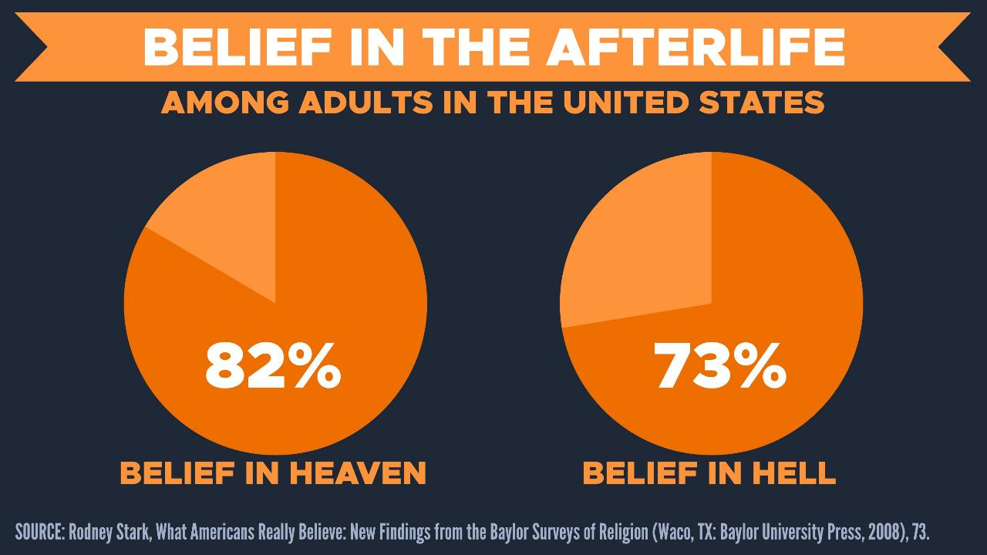
“Just one-half of 1 percent expect to go to Hell upon their death.”
Barna Research Group, “Americans Describe Their Views about Life after Death,” October 21, 2003.

Slide 13
“Burning sulfur… Lake of fire.”
(1) Most theologians don’t think this imagery is literal.
Calvin, Hodge, Beale, Ladd, Morris, Geisler, etc.
John Calvin, Institutes of the Christian Religion. 3.25.12.
Gordon Lewis, Integrative Theology (Grand Rapids: Zondervan, 1994), 3:470. 474.
Charles Hodge, Systematic Theology (Oak Harbor, WA, 1952), 868.
G.K. Beale, Revelation (Grand Rapids, MI. W.B. Eerdmans, 1999), 1029.
Kenneth Boa and Robert Bowman, Sense and Nonsense About Heaven and Hell, 118.
George Ladd, A Theology of the New Testament (Grand Rapids, MI: Eerdmans, 1974), 196.
Robert A. Peterson, Hell on Trial (Phillipsburg, NJ: P&R Publishing, 1995), 192.
Bruce Milne, The Message of Heaven and Hell (IL: InterVarsity Press, 2002) 149.
Leon Morris, Revelation (Downers Grove, IL: InterVarsity Press, 1987), 174.
Robert Morey, Death and the Afterlife (Minneapolis, MN: Bethany House, 1984), 101.
Norman Geisler, Baker Encyclopedia of Christian Apologetics (Baker, 1999), 312.
J.P. Moreland, The Case for Christ (Grand Rapids, MI: Zondervan, 2000), 176-177.

Slide 14
“Burning sulfur… Lake of fire.”
(1) Most theologians don’t think this imagery is literal.
Calvin, Hodge, Beale, Ladd, Morris, Geisler, etc.
(2) The Bible often uses the word “fire” symbolically—not literally.
Deuteronomy 4:24; Proverbs 6:27-29; Hosea 7:6; Jas. 3:6; Hebrews 12:29
“Our God is a consuming fire.”
Hebrews 12:29

Slide 15
“Burning sulfur… Lake of fire.”
(1) Most theologians don’t think this imagery is literal.
Calvin, Hodge, Beale, Ladd, Morris, Geisler, etc.
(2) The Bible often uses the word “fire” symbolically—not literally.
Deuteronomy 4:24; Proverbs 6:27-29; Hosea 7:6; Jas. 3:6; Hebrews 12:29
(3) The “flames” of hell judge Satan.
Revelation 20:10; Matthew 25:41

Slide 16
“Burning sulfur… Lake of fire.”
(1) Most theologians don’t think this imagery is literal.
Calvin, Hodge, Beale, Ladd, Morris, Geisler, etc.
(2) The Bible often uses the word “fire” symbolically—not literally.
Deuteronomy 4:24; Proverbs 6:27-29; Hosea 7:6; Jas. 3:6; Hebrews 12:29
(3) The “flames” of hell judge Satan.
Revelation 20:10; Matthew 25:41
(4) Hell is a place of darkness.
Matthew 8:12; 22:13; 25:30; 2 Peter 2:4; Jude 13
“[They] will be cast out into the outer darkness.”
Matthew 8:12; cf. 22:13; 25:30
“Black darkness has been reserved forever.”
Jude 13; cf. 2 Peter 2:4

Slide 17
“Burning sulfur… Lake of fire.”
(1) Most theologians don’t think this imagery is literal.
Calvin, Hodge, Beale, Ladd, Morris, Geisler, etc.
(2) The Bible often uses the word “fire” symbolically—not literally.
Deuteronomy 4:24; Proverbs 6:27-29; Hosea 7:6; Jas. 3:6; Hebrews 12:29
(3) The “flames” of hell judge Satan.
Revelation 20:10; Matthew 25:41
(4) Hell is a place of darkness.
Matthew 8:12; 22:13; 25:30; 2 Peter 2:4; Jude 13
We shouldn’t take the flames literally,
but we should take them seriously!

Slide 18
Is it unloving for God to judge?
Imagine a judge who never passed judgment on anyone.
Mandy Boardman: Would that be a loving judge?
We criticize God for allowing so much evil and suffering in the world…
but then we criticize him for doing anything about it!

Slide 19
Are humans really that bad?
(1) Biblical evidence
Matthew 7:9-11; 23:25-28; Romans 3:23; 1 Kings 8:46; Ecclesiastes 7:20; Psalm 130:3; Psalm 143:2
Jesus said, “If you, then, though you are evil, know how to give good gifts to your children,
how much more will your Father in heaven give good gifts to those who ask him!”
Matthew 7:11

Slide 20
Are humans really that bad?
(1) Biblical evidence
Matthew 7:9-11; 23:25-28; Romans 3:23; 1 Kings 8:46; Ecclesiastes 7:20; Psalm 130:3; Psalm 143:2
(2) Philosophical evidence
What if we were unable to hide our thoughts, intentions, and desires from others?

Slide 21
Are humans really that bad?
(1) Biblical evidence
Matthew 7:9-11; 23:25-28; Romans 3:23; 1 Kings 8:46; Ecclesiastes 7:20; Psalm 130:3; Psalm 143:2
(2) Philosophical evidence
What if we were unable to hide our thoughts, intentions, and desires from others?
(3) Historical evidence
Transcultural, universal human evil throughout time

Slide 22
Are humans really that bad?
(1) Biblical evidence
Matthew 7:9-11; 23:25-28; Romans 3:23; 1 Kings 8:46; Ecclesiastes 7:20; Psalm 130:3; Psalm 143:2
(2) Philosophical evidence
What if we were unable to hide our thoughts, intentions, and desires from others?
(3) Historical evidence
Transcultural, universal human evil throughout time
Nazi Germany: 6 million Jews.
+ 5 million others!
Soviet Union: 20-54 million prisoners.
(1917-1989) Stéphane Courtois, The Black Book of Communism: Crimes, Terror, Repression (Cambridge: Harvard, 1999), 4.
R.J. Rummel, “Soviet Union, Genocide In” Encyclopedia of Genocide (Santa Barbara, CA: ABC-CLIO, 1999), vol. 2, 520.
China: ~30 million counter-revolutionaries.
Stéphane Courtois, The Black Book of Communism: Crimes, Terror, Repression (Cambridge: Harvard, 1999), 4.
Japan: 300,000 Chinese.
(1937) Iris Chang, The Rape of Nanking: The Forgotten Holocaust of World War II (New York: Basic Books, 1998), 6.
The United States…?

Slide 23
Are humans really that bad?
(1) Biblical evidence
Matthew 7:9-11; 23:25-28; Romans 3:23; 1 Kings 8:46; Ecclesiastes 7:20; Psalm 130:3; Psalm 143:2
(2) Philosophical evidence
What if we were unable to hide our thoughts, intentions, and desires from others?
(3) Historical evidence
Transcultural, universal human evil throughout time
What sort of people commit sadistic acts of evil?
Regular people!

Slide 24
Harald Welzer
(German social psychologist)
Harald Welzer, “On Killing and Morality: How Normal People Become Mass Murderers,” Ordinary People as Mass Murderers (New York: Macmillan, 2008), 148-149.
As we look at the perpetrators of genocide and mass killing, we need no longer ask who these people are.
We know who they are.
They are you and I.

Slide 25
Harald Welzer
(German social psychologist)
Harald Welzer, “On Killing and Morality: How Normal People Become Mass Murderers,” Ordinary People as Mass Murderers (New York: Macmillan, 2008), 148-149.
As we look at the perpetrators of genocide and mass killing, we need no longer ask who these people are.
We know who they are.
They are you and I.

Slide 26
Are humans really that bad?
(1) Biblical evidence
Matthew 7:9-11; 23:25-28; Romans 3:23; 1 Kings 8:46; Ecclesiastes 7:20; Psalm 130:3; Psalm 143:2
(2) Philosophical evidence
What if we were unable to hide our thoughts, intentions, and desires from others?
(3) Historical evidence
Transcultural, universal human evil throughout time
(4) Psychological evidence
Stanley Milgram Experiment; cf. D.M. Mantell, “The Potential for Violence in Germany,” 27:110-11.

Slide 27
How did it work?
Subject: pressed the switch to “electrocute” the test subject.
Experimenter: told the subject to keep increasing the voltage—until it was “fatal.”
Fake test subject: pretended to be dying on the other side of the wall.
Gave 15-450 volts.

Slide 28
How did it work?
Subject: pressed the switch to “electrocute” the test subject.
Experimenter: told the subject to keep increasing the voltage—until it was “fatal.”
Fake test subject: pretended to be dying on the other side of the wall.
Gave 15-450 volts.
65% administered the lethal shock!!

Slide 29
Are humans really that bad?
(1) Biblical evidence
Matthew 7:9-11; 23:25-28; Romans 3:23; 1 Kings 8:46; Ecclesiastes 7:20; Psalm 130:3; Psalm 143:2
(2) Philosophical evidence
What if we were unable to hide our thoughts, intentions, and desires from others?
(3) Historical evidence
Transcultural, universal human evil throughout time
(4) Psychological evidence
Stanley Milgram Experiment; cf. D.M. Mantell, “The Potential for Violence in Germany,” 27:110-11.

Slide 30
Are humans really that bad?
(1) Biblical evidence
Matthew 7:9-11; 23:25-28; Romans 3:23; 1 Kings 8:46; Ecclesiastes 7:20; Psalm 130:3; Psalm 143:2
(2) Philosophical evidence
What if we were unable to hide our thoughts, intentions, and desires from others?
(3) Historical evidence
Transcultural, universal human evil throughout time
(4) Psychological evidence
Stanley Milgram Experiment; cf. D.M. Mantell, “The Potential for Violence in Germany,” 27:110-11.
(5) Sociological evidence
Who contributed more?
MARRIAGE: “What percent of chores do you do?”
Consistently over 100%
Nicholas Epley, Mindwise (New York, Vintage Books, 2014), 93.
STUDENTS: “What percent of group work did you do?”
Over 200%
Juliana Schroeder, “Who’s Really Doing the Work?” (2017), Vol. 60 (1), 91.
SCHOLARS: “What percent did you add to an article?”
Between 205-261%
Eugene Caruso (et al.), “The Costs and Benefits of Undoing Egocentric Responsibility Assessments in Groups” Journal of Personality and Social Psychology, 2006, Vol. 91, No. 5, 857–871.

Slide 31
Are humans really that bad?
(1) Biblical evidence
Matthew 7:9-11; 23:25-28; Romans 3:23; 1 Kings 8:46; Ecclesiastes 7:20; Psalm 130:3; Psalm 143:2
(2) Philosophical evidence
What if we were unable to hide our thoughts, intentions, and desires from others?
(3) Historical evidence
Transcultural, universal human evil throughout time
(4) Psychological evidence
Stanley Milgram Experiment; cf. D.M. Mantell, “The Potential for Violence in Germany,” 27:110-11.
(5) Sociological evidence
Are you above average?
Majority of students with intelligence
R. C. Wylie, The Self-Concept, vol. 2 (Lincoln: University of Nebraska Press, 1979).
Majority of managers with competence
L. Larwood and W. Whittaker, “Managerial Myopia” Journal of Applied Psychology 62: 194-98 (1977).
90% of motorists with skill & safety
D. Walton & J. Bathurst, “An Exploration of the Perceptions of the Average Driver’s Speed Compared to Perceived Driver Safety and Driving Skill,” Accident Analysis and Prevention 30: 821-30 (1998).
94% of professors with teaching
P. Cross, “Not Can but Will College Teachers Be Improved?” New Directions for Higher Education.
Majority of people think they’re less biased!
E. Pronin, “The Bias Blind Spot” Personality and Social Psychology Bulletin 28: 369-81 (2002).

Slide 32
Cindi May
(Psychology Prof at College of Charleston)
Cindy May, “Most People Consider Themselves to Be Morally Superior,” Scientific American (January 31, 2017).
When comparing ourselves versus other people, we tend to rate ourselves more highly on a host of positive measures,
including intelligence, ambition, friendliness, and modesty (ha!).

Slide 33
Cindi May
(Psychology Prof at College of Charleston)
Cindy May, “Most People Consider Themselves to Be Morally Superior,” Scientific American (January 31, 2017).
We are most irrational…
when we consider moral traits.

Slide 34
Are humans really that bad?
(1) Biblical evidence
Matthew 7:9-11; 23:25-28; Romans 3:23; 1 Kings 8:46; Ecclesiastes 7:20; Psalm 130:3; Psalm 143:2
(2) Philosophical evidence
What if we were unable to hide our thoughts, intentions, and desires from others?
(3) Historical evidence
Transcultural, universal human evil throughout time
(4) Psychological evidence
Stanley Milgram Experiment; cf. D.M. Mantell, “The Potential for Violence in Germany,” 27:110-11.
(5) Sociological evidence
What if I still don’t think that I’m sinful after all of this evidence…?

Slide 35
Are humans really that bad?
(1) Biblical evidence
Matthew 7:9-11; 23:25-28; Romans 3:23; 1 Kings 8:46; Ecclesiastes 7:20; Psalm 130:3; Psalm 143:2
(2) Philosophical evidence
What if we were unable to hide our thoughts, intentions, and desires from others?
(3) Historical evidence
Transcultural, universal human evil throughout time
(4) Psychological evidence
Stanley Milgram Experiment; cf. D.M. Mantell, “The Potential for Violence in Germany,” 27:110-11.
(5) Sociological evidence
Then, you’re guilty
of a very serious sin:
Self-righteousness!

Slide 36
Why does judgment still seem to bother us so much?
“As surely as I live… I take no pleasure in the death of wicked people.
I only want them to turn from their wicked ways so they can live.
Turn! Turn from your wickedness, O people of Israel! Why should you die?”
Ezekiel 33:11

Slide 37
Why does judgment still seem to bother us so much?
“[God] does not willingly bring affliction or grief to any human being.”
Lamentations 3:33
“It is not the will of your Father who is in heaven that one of these little ones perish.”
Matthew 18:14

Slide 38
Why does judgment still seem to bother us so much?
“God is patient with you, not wanting anyone to perish, but everyone to come to repentance.”
2 Peter 3:9
“God wants all people to be saved and to come to a knowledge of the truth.”
1 Timothy 2:4

Slide 39
Why does judgment still seem to bother us so much?
“God is patient with you, not wanting anyone to perish, but everyone to come to repentance.”
2 Peter 3:9
“God wants all people to be saved and to come to a knowledge of the truth.”
1 Timothy 2:4
Why does Hell bother us?
Because it bothers God!

Slide 40
Conclusions
Jesus taught more about hell than any other biblical figure.
Matthew 5:22; 5:29-30; 10:28; 13:49-50; 18:8-9; 23:15; 33; 25:46; Mark 9:43; Luke 16:19-31
Wouldn’t it be just terrible if you sat through this entire teaching on Hell…
And you ended up going there?

Slide 41
Conclusions
Jesus taught more about hell than any other biblical figure.
Matthew 5:22; 5:29-30; 10:28; 13:49-50; 18:8-9; 23:15; 33; 25:46; Mark 9:43; Luke 16:19-31
Wouldn’t it be just terrible if you sat through this entire teaching on Hell…
And you ended up going there?
(Ephesians 2:8-9) God saved you by his grace when you believed. And you can’t take credit for this. It is a gift from God.
Salvation is not a reward for the good things we have done, so no one can boast about it.

Slide 43
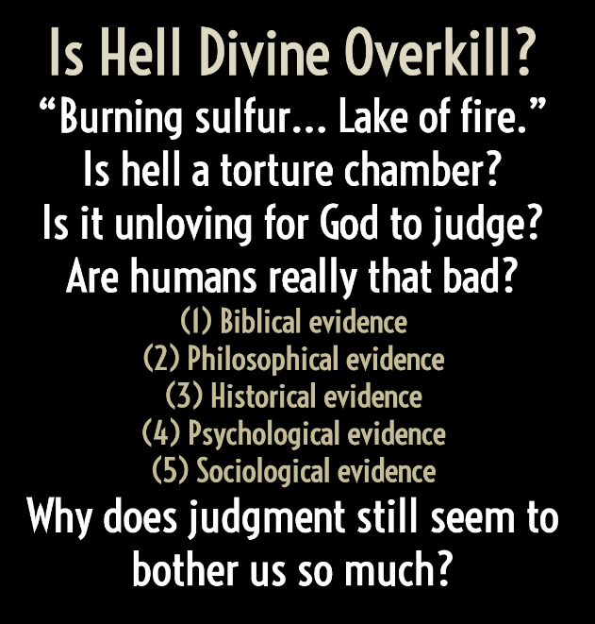

Slide 44
Why is judgment eternal for finite sins?
Ongoing punishment for ongoing sin.
Revelation 22:11; Michael J. Murray, Reason for the Hope Within (Grand Rapids, MI: Eerdmans, 1999), 293.
The duration of the crime shouldn’t be the duration of the punishment.
e.g. 100 seconds to strangle someone.
The severity of a moral act depends on the object, not just the action.
e.g. inflicting harm on a bug… dog… kid… God.
We have all morally violated God.
(Rev. 22:11) Let the one who is doing harm continue to do harm.
(Mt. 25:45) Jesus said,
“Whatever you did not do for one of the least of these, you did not do for Me.”

Slide 45
Is hell a torture chamber?
“Torment” does not refer to torture.
Revelation 20:10
In hell, Jesus said that there “will be weeping and gnashing of teeth.”
Matthew 8:12
(Acts 7:54) [Stephen’s killers] were furious and gnashed their teeth at him.
“Weeping” refers to regret and mourning.
Matthew 2:18; Mark 5:38; Luke 23:28; John 11:33-35; 20:11, etc.
Norman L. Geisler, If God, Why Evil?: A New Way to Think about the Question (Minneapolis, MN: Bethany House, 2011), 104.
“Gnashing of teeth” refers to anger and hostility.
Acts 7:54; Job 16:9; Ps. 35:16; 37:12; Lam. 2:16

