Slide 2
(Jn. 7:1) After this, Jesus went around in Galilee. He did not want to go about in Judea because the Jewish leaders there were looking for a way to kill him.
² The Jewish Festival of Tabernacles was near.
Six months have passed.
Passover (March/April, Jn. 6:4) to the Feast of Tabernacles (September/October).

Slide 3
(Jn. 7:3) Jesus’ brothers said to him,
“Leave Galilee and go to Judea, so that your disciples there may see the works you do.
John 6:66

Slide 4
(Jn. 7:3) Jesus’ brothers said to him,
“Leave Galilee and go to Judea, so that your disciples there may see the works you do. ⁴ No one who wants to become a public figure acts in secret.
Since you are doing these things, show yourself to the world.”
⁵ For even his own brothers did not believe in him.

Slide 5
(Jn. 7:6) Therefore Jesus told them,
“My time is not yet here.
For you any time will do.
⁷ The world cannot hate you, but it hates me because I testify that its works are evil.”

Slide 6
(Jn. 7:8) “You go to the festival. I am not going up to this festival, because my time has not yet fully come.”
The religious leaders were setting a trap to kill him.
John 7:1, 11

Slide 7
(Jn. 7:9) After he had said this, he stayed in Galilee.
¹⁰ However, after his brothers had left for the festival, he went also,
not publicly, but in secret.

Slide 8
(Jn. 7:11) Now at the festival the Jewish leaders were watching for Jesus and asking, “Where is he?”
¹² Among the crowds there was widespread whispering about him.
Some said,
“He is a good man.”

Slide 11
John Stuart Mill
(Philosopher and Skeptic of Christianity)
John Stuart Mill, Three Essays on Religion (3rd ed. London: Longmans, Green, Beader, and Dyer, 1874), 254-255.
About the life and sayings of Jesus there is a stamp of personal originality combined with profundity of insight… in the very first rank of men of sublime genius of whom our species can boast.

Slide 12
John Stuart Mill
(Philosopher and Skeptic of Christianity)
John Stuart Mill, Three Essays on Religion (3rd ed. London: Longmans, Green, Beader, and Dyer, 1874), 254-255.
[This] pre-eminent genius is combined with the qualities of probably the greatest moral reformer, and martyr to that mission, who ever existed upon earth… [He is the] ideal representative and guide of humanity.

Slide 13
Jesus claimed to be God
(Jn. 1:1) In the beginning was the Word,
and the Word was with God,
and the Word was God.
(Jn. 10:30) “I and the Father are one.”
(Jn. 20:28) Thomas said,
“My Lord and my God!”

Slide 14
Jesus claimed to be God
Jesus’ favorite self-designation was “the Son of Man.”

Slide 15
Jesus claimed to be God
Jesus’ favorite self-designation was “the Son of Man.”
(Dan. 7:13) There before me was one like a son of man, coming with the clouds of heaven. He approached the Ancient of Days and was led into his presence.
¹⁴ He was given authority, glory and sovereign power. All peoples, nations and men of every language worshiped him.

Slide 16
Jesus claimed to be God
Jesus’ favorite self-designation was “the Son of Man.”
(Mk. 14:61) The high priest asked him,
“Are you the Messiah, the Son of the Blessed One?”
⁶² Jesus said, “I Am.
And you will see the Son of Man seated in the place of power at God’s right hand and coming on the clouds of heaven.”

Slide 17
Jesus claimed to be God
Jesus’ favorite self-designation was “the Son of Man.”
(Mk. 14:63) Then the high priest tore his clothing to show his horror and said,
“Why do we need other witnesses?
⁶⁴ You have all heard his blasphemy. What is your verdict?”
“Guilty!” they all cried. “He deserves to die!”

Slide 18
How can Jesus give us sound ethical teaching,
when he made the most egotistical claims about himself?
Jesus claimed to be God
Jesus’ favorite self-designation was “the Son of Man.”
(Mk. 14:63) Then the high priest tore his clothing to show his horror and said,
“Why do we need other witnesses?
⁶⁴ You have all heard his blasphemy. What is your verdict?”
“Guilty!” they all cried. “He deserves to die!”

Slide 19
(Jn. 7:11) Now at the festival the Jewish leaders were watching for Jesus and asking, “Where is he?”
¹² Among the crowds there was widespread whispering about him. Some said,
“He is a good man.”
Others replied,
“No, he deceives the people.”

Slide 21
Deceivers buckle under pressure.

Slide 22
Deceivers buckle under pressure.
Deceivers don’t defend the victims…
…they victimize the defenseless!

Slide 23
Deceivers buckle under pressure.
Deceivers don’t defend the victims…
…they victimize the defenseless!
Deceivers need a sufficient motive.

Slide 24
Money?
Luke 9:58; Matthew 17:24
Power?
John 6:15; 18:36
Sex?
John Dominic-Crossan, “Why Jesus Didn’t Marry”
http://www.beliefnet.com/
Deceivers buckle under pressure.
Deceivers don’t defend the victims…
…they victimize the defenseless!
Deceivers need a sufficient motive.

Slide 25
(Jn. 7:11) Now at the festival the Jewish leaders were watching for Jesus and asking, “Where is he?”
¹² Among the crowds there was widespread whispering about him. Some said,
“He is a good man.”
Others replied,
“No, he deceives the people.”

Slide 26
(Jn. 7:13) But no one would say anything publicly about him for fear of the leaders.

Slide 27
(Jn. 7:14) Not until halfway through the festival did Jesus go up to the temple courts and begin to teach.
¹⁵ The Jews there were amazed and asked, “How did this man get such learning without having been taught?”

Slide 28
(Jn. 7:16) Jesus answered,
“My teaching is not my own. It comes from the one who sent me.
¹⁷ Anyone who chooses to do the will of God will find out whether my teaching comes from God or whether I speak on my own.”
Are you willing?

Slide 29
(Jn. 7:18) “Whoever speaks on their own does so to gain personal glory,
but he who seeks the glory of the one who sent him is a man of truth.
There is no unrighteousness in Him.
¹⁹ Has not Moses given you the law? Yet not one of you keeps the law.
Why are you trying to kill me?”

Slide 30
(Jn. 7:20) The crowd replied,
“You are demon possessed!
Who’s trying to kill you?”
“He has a demon and is insane!”
John 10:20

Slide 32
Jesus made this claim in a first-century Jewish context.
“A measure of your insanity is the size of the gap between what you think you are and what you really are.”
Peter Kreeft, Fundamentals of the Faith (San Francisco, CA: Ignatius Press, 1988), 60-61.

Slide 33
Jesus made this claim in a first-century Jewish context.
The NT includes this accusation.
(Jn. 7:20; 10:20; Mt. 12:22-29; Mk. 3:21)

Slide 34
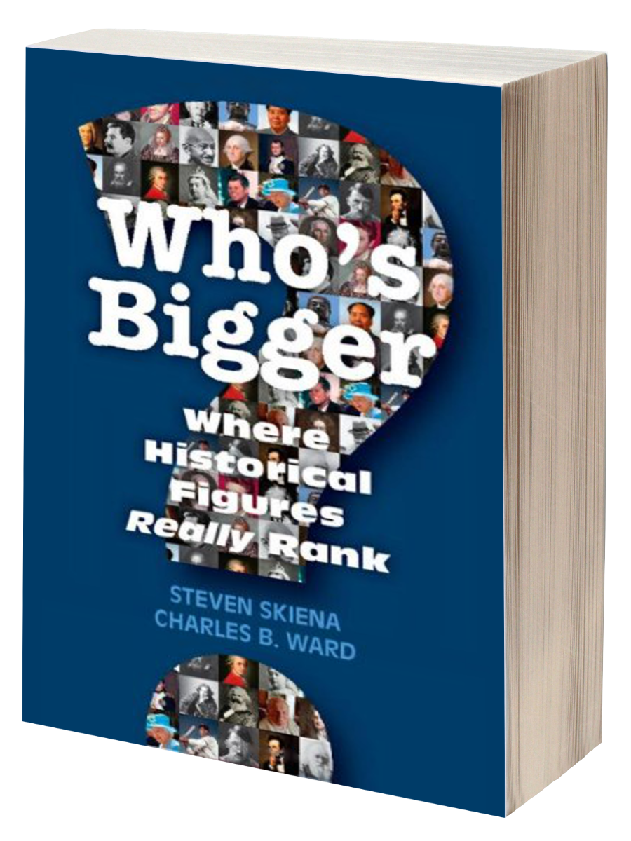
Jesus made this claim in a first-century Jewish context.
The NT includes this accusation.
(Jn. 7:20; 10:20; Mt. 12:22-29; Mk. 3:21)
Was the world transformed by a delusional, narcissistic maniac?

Slide 35
Jesus made this claim in a first-century Jewish context.
The NT includes this accusation.
(Jn. 7:20; 10:20; Mt. 12:22-29; Mk. 3:21)
Was the world transformed by a delusional, narcissistic maniac?
Psychotic, megalomaniacs are not difficult to identify…

Slide 37
Jesus made this claim in a first-century Jewish context.
The NT includes this accusation.
(Jn. 7:20; 10:20; Mt. 12:22-29; Mk. 3:21)
Was the world transformed by a delusional, narcissistic maniac?
Psychotic, megalomaniacs are not difficult to identify…
Jesus’ closest disciples went to their deaths believing in him.

Slide 41
Jesus made this claim in a first-century Jewish context.
The NT includes this accusation.
(Jn. 7:20; 10:20; Mt. 12:22-29; Mk. 3:21)
Was the world transformed by a delusional, narcissistic maniac?
Psychotic, megalomaniacs are not difficult to identify…

Slide 42
(Jn. 7:28) Then Jesus, still teaching in the temple courts, cried out,
“Yes, you know me, and you know where I am from. I am not here on my own authority, but he who sent me is true. You do not know him,
²⁹ but I know him because I am from him and he sent me.”

Slide 43
(Jn. 7:30) At this they tried to seize him, but no one laid a hand on him, because his hour had not yet come.
³¹ Still, many in the crowd believed in him. They said, “When the Messiah comes, will he perform more signs than this man?”

Slide 44
(Jn. 7:37) On the last and greatest day of the Jewish Festival of Tabernacles, Jesus stood.

Slide 45
(Jn. 7:37) On the last and greatest day of the Jewish Festival of Tabernacles, Jesus stood.
The Feast of Tabernacles
Sukkah 3:9; 4:4-10; 5:1-4
Days 1-6: The people carried water from the Pool of Siloam to the Temple, and the people sang the Hallel (Pss. 113-118). Then, the priest poured their water onto the altar.
Day 7: Celebration was at its peak!
Day 8: Somber! No more water pouring or singing. Many rabbis taught that the Messiah would come to bring water.
Qohelet Rabbah, 1:9.1

Slide 46
(Jn. 7:37) On the last and greatest day of the Jewish Festival of Tabernacles, Jesus stood.
Jesus said in a loud voice,
“Let anyone who is thirsty come to me and drink!
³⁸ Whoever believes in me, as Scripture has said, rivers of living water will flow from within them!”

Slide 47
(Jn. 7:39) When Jesus said “living water,” he was speaking of the Spirit, who would be given to everyone believing in him. But the Spirit had not yet been given, because Jesus had not yet entered into his glory.

Slide 48
(Jn. 7:40) On hearing his words, some of the people said,
“Surely this man is the Prophet.”
⁴¹ Others said, “He is the Messiah.”
⁴³ Thus the people were divided because of Jesus.

Slide 56
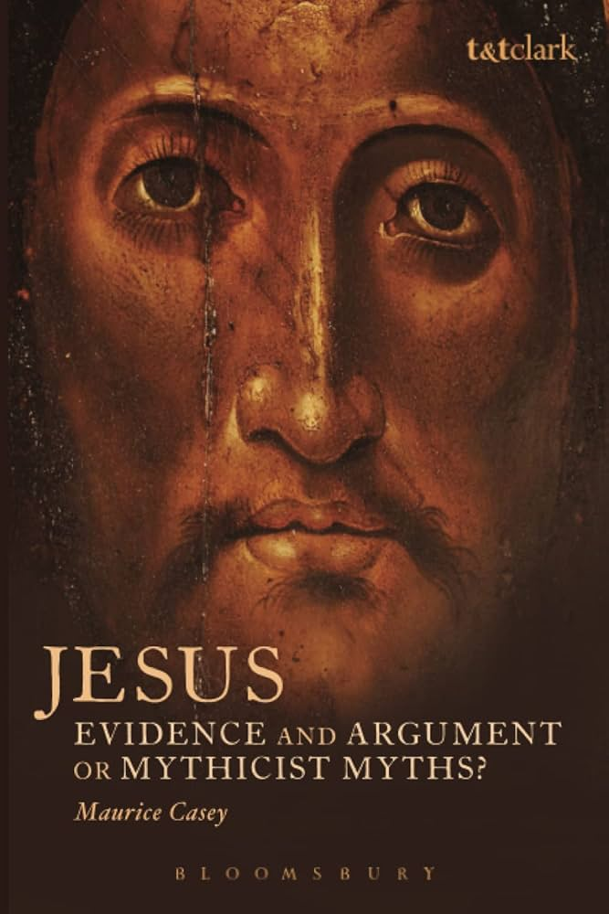
Maurice Casey
(Professor at the University of Nottingham)
Maurice Casey, Jesus: Evidence and Argument or Mythicist Myths? (London: Bloomsbury Academic, 2014), 3, 39.
Casey “left the Christian faith in 1962” and calls himself “completely irreligious.”

Slide 57
Maurice Casey
(Professor at the University of Nottingham)
Maurice Casey, Jesus: Evidence and Argument or Mythicist Myths? (London: Bloomsbury Academic, 2014), 243.
The whole idea that Jesus of Nazareth did not exist as a historical figure is verifiably false.
It has not been produced by anyone or anything with any reasonable relationship to critical scholarship.

