Slide 1
1 Corinthians
Chapter one part 2 – The Centrality of Unity

Slide 2
Last Time
Paul goes to Corinth from Athens
He is terrified of their culture
They get a strong start
He gets word that they are a hot mess

Slide 3
1 Corinthians Chapter 1
9 God is faithful, through whom you were called into fellowship with His Son, Jesus Christ our Lord.10 Now I exhort you, brethren, by the name of our Lord Jesus Christ, that you all agree and that there be no divisions among you,

Slide 4
1 Corinthians Chapter 1
but that you be made complete in the same mind and in the same judgment. 11 For I have been informed concerning you, my brethren, by Chloe’s people, that there are quarrels among you.

Slide 5
1 Corinthians Chapter 1
Of all the sins in the church at Corinth Paul goes after disunity first.
but that you be made complete in the same mind and in the same judgment. 11 For I have been informed concerning you, my brethren, by Chloe’s people, that there are quarrels among you.

Slide 6
Unity
Disunity is death to Christian community
Matt 3:24 “If a kingdom is divided against itself, that kingdom cannot stand. 25 “If a house is divided that house will not be able to stand

Slide 7
Unity
We will have no witness to the outside world
Jn 13:34 “A new commandment I give to you, that you love one another, even as I have loved you, that you also love one another. 35 “By this all men will know that you are My disciples, if you have love for one another.”

Slide 8
Unity
Jn 17:19 “For their sakes I sanctify Myself, that they themselves also may be sanctified in truth. 20 “I do not ask on behalf of these alone, but for those also who believe in Me through their word; 21 that they may all be one; even as You, Father, are in Me and I in You,

Slide 9
Unity
that they also may be in Us, so that the world may believe that You sent Me. 22 “The glory which You have given Me I have given to them, that they may be one, just as We are one; 23 I in them and You in Me, that they may be perfected in unity,

Slide 10
Unity
so that the world may know that You sent Me, and loved them, even as You have loved Me.

Slide 11
Types of disunity
Passive disunity
Harboring anger/resentment
Forming Cliques
The cold shoulder
Gossip
Passive aggressive comments

Slide 12
Types of disunity
Active Disunity
Verbal attacks
Undermining
Seeking revenge
Breaking fellowship

Slide 13
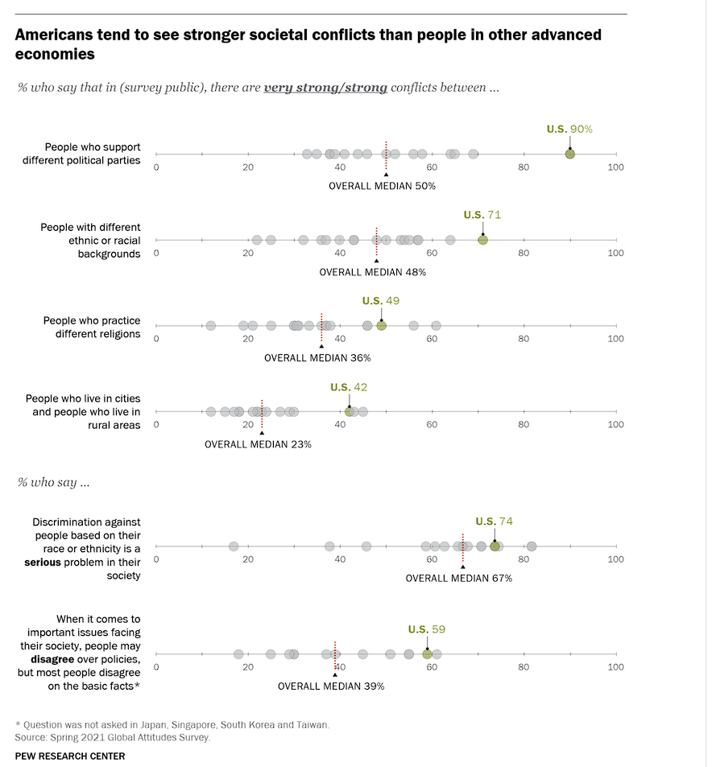
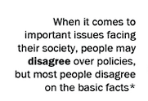
Our culture is super disunified
Median =50% US=90%
Median =48% US=71%
Median =39% US=59%

Slide 14
Our church is impacted by culture
More affective conflict
Things coming up from 10-15 years ago
Subjective interpretation
Demanding punishment of others

Slide 15
Overlooking minor offenses
“First, the offense should not have created a wall between you and the other per­son or caused you to feel differently toward him or her for more than a short period of time. Second, the offense should not be doing serious harm to God’s reputation, to others, or to the offender”
-Ken Sande “The Peacemaker”

Slide 16
Overlooking Minor Offenses
Proverbs 19:11 (NLT) — 11 Sensible people control their temper; they earn respect by overlooking wrongs.

Slide 17
Overlooking Minor Offenses
Proverbs 20:3 (NASB95) — 3 Keeping away from strife is an honor for a man, But any fool will quarrel.

Slide 18
Overlooking Minor Offenses
Proverbs 17:14 (NASB95) — 14 The beginning of strife is like letting out water, So abandon the quarrel before it breaks out.

Slide 19
Count the Cost
Psalm 73:21–22 (NASB95) — 21 When my heart was embittered And I was pierced within, 22 Then I was senseless and ignorant; I was like a beast before You.

Slide 20
Guidance for confrontation
There are many conflicts that can be properly resolved only through confrontation, confession, forgiveness, and cooperative negotiation. But there are hundreds more that can be properly resolved simply by overlooking minor offenses or relinquishing rights for the sake of God’s kingdom. Therefore, before focusing on your rights, take a careful look at your responsibilities, and before you go to remove the speck from your brother’s eye, ask yourself, “Is this really worth fighting over?”
-Ken Sande “The Peacemaker”

Slide 21
Guidance for confrontation
On the other hand, the Bible teaches that it is sometimes appro­priate to exercise our rights, to confront others, and to hold them fully accountable for their responsibilities and their wrongs. Here again the concept of stewardship serves as a guiding principle.

Slide 22
Guidance for confrontation
“Will exercising my rights please and honor God?”
“Will exercising my rights advance God’s kingdom—or will it advance only my interests at the expense of his kingdom?”
Ken Sande “The Peacemaker”

Slide 23
Unity
God’s enemies know they cannot overcome a unified Christian community

Slide 24
Unity
“Later I realized that one can't break the Church over one's knee. It has to be left to rot like a gangrenous limb . . . . “
-Adolph Hitler
Conway, J.S., The Nazi Persecution of the Churches, 1933-45
God’s enemies know they cannot overcome a unified Christian community

Slide 25
Unity
With all the problems in Corinth Paul is most concerned with the disunity among them

Slide 26
1 Corinthians Chapter 1
12 Now I mean this, that each one of you is saying, “I am of Paul,” and “I of Apollos,” and “I of Cephas,” and “I of Christ.”13 Has Christ been divided? Paul was not crucified for you, was he? Or were you baptized in the name of Paul?

Slide 27
1 Corinthians Chapter 1
The main cause of disunity in Corinth?
12 Now I mean this, that each one of you is saying, “I am of Paul,” and “I of Apollos,” and “I of Cephas,” and “I of Christ.”13 Has Christ been divided? Paul was not crucified for you, was he? Or were you baptized in the name of Paul?

Slide 28
1 Corinthians Chapter 1
The main cause of disunity in Corinth?
-Putting leaders on pedestals and making cliques
12 Now I mean this, that each one of you is saying, “I am of Paul,” and “I of Apollos,” and “I of Cephas,” and “I of Christ.”13 Has Christ been divided? Paul was not crucified for you, was he? Or were you baptized in the name of Paul?

Slide 29
1 Corinthians Chapter 1
The main cause of disunity in Corinth?
-Putting leaders on pedestals and making cliques
-False teaching
-Taking each other to court
12 Now I mean this, that each one of you is saying, “I am of Paul,” and “I of Apollos,” and “I of Cephas,” and “I of Christ.”13 Has Christ been divided? Paul was not crucified for you, was he? Or were you baptized in the name of Paul?

Slide 30
1 Corinthians Chapter 1
12 Now I mean this, that each one of you is saying, “I am of Paul,” and “I of Apollos,” and “I of Cephas,” and “I of Christ.”13 Has Christ been divided? Paul was not crucified for you, was he? Or were you baptized in the name of Paul?

Slide 31
1 Corinthians Chapter 1
12 Now I mean this, that each one of you is saying, “I am of Paul,” and “I of Apollos,” and “I of Cephas,” and “I of Christ.”13 Has Christ been divided? Paul was not crucified for you, was he? Or were you baptized in the name of Paul?

Slide 32
1 Corinthians Chapter 1
12 Now I mean this, that each one of you is saying, “I am of Paul,” and “I of Apollos,” and “I of Cephas,” and “I of Christ.”13 Has Christ been divided? Paul was not crucified for you, was he? Or were you baptized in the name of Paul?

Slide 33
1 Corinthians Chapter 1
12 Now I mean this, that each one of you is saying, “I am of Paul,” and “I of Apollos,” and “I of Cephas,” and “I of Christ.”13 Has Christ been divided? Paul was not crucified for you, was he? Or were you baptized in the name of Paul?

Slide 34
Leaders are just people
Arguments were breaking out among them about who belonged to who
Who was the better preacher
Who was the better leader

Slide 35
Leaders are just people
Arguments were breaking out among them about who belonged to who
Who was the better preacher
Who was the better leader
But it is Christ who is the entire basis for our unity and our love!

Slide 36
1 Corinthians Chapter 1
14 I thank God that I baptized none of you except Crispus and Gaius, 15 so that no one would say you were baptized in my name.16 Now I did baptize also the household of Stephanas; beyond that, I do not know whether I baptized any other.

Slide 37
1 Corinthians Chapter 1
17 For Christ did not send me to baptize, but to preach the gospel, not in cleverness of speech, so that the cross of Christ would not be made void.

Slide 38
Consumer Christianity
Paul is disgusted with their consumer mind set toward Christ
What is in it for me?
Who can best meet my needs?
How can I lift myself up over others?
Rather than what can I contribute to the cause of Christ.

Slide 39
Be diligent to preserve unity
This is something that takes concerted effort on our part, we must be intentional, active and outward.
Accountable- We have to seek the counsel of others

Slide 40
How to preserve unity
Beware of the root of bitterness
Heb 12:15 See to it that no one comes short of the grace of God; that no root of bitterness springing up causes trouble, and by it many be defiled;

Slide 41
How to preserve unity
Beware of the root of bitterness
Be proactive in resolving disputes
Not all disputes can be resolved
Rom 12:18 If possible, so far as it depends on you, be at peace with all men.

Slide 42
How to preserve unity
Beware of the root of bitterness
Be proactive in resolving disputes
Don’t be passive about people who sow disunity

Slide 43
How to preserve unity
Tit. 3:10 Reject a factious man after a first and second warning, 11 knowing that such a man is perverted and is sinning, being self-condemned.
Beware of the root of bitterness
Be proactive in resolving disputes
Don’t be passive about people who sow disunity

Slide 44
Remember how God resolved his conflict with us
1 Peter 3:18 (NASB95) — 18 For Christ also died for sins once for all, the just for the unjust, so that He might bring us to God, having been put to death in the flesh, but made alive in the spirit;

Slide 45
Remember how God resolved his conflict with us
Phil 2:5 Have this attitude in yourselves which was also in Christ Jesus, 6 who, although He existed in the form of God, did not regard equality with God a thing to be grasped, 7 but emptied Himself, taking the form of a bond-servant, and being made in the likeness of men.
1 Peter 3:18 (NASB95) — 18 For Christ also died for sins once for all, the just for the unjust, so that He might bring us to God, having been put to death in the flesh, but made alive in the spirit;

Slide 46
2 ways this can go
We as God’s followers can stand out against the culture of our time and really shine
We can follow our cultures lead and tear one another apart.

Slide 47
Next Time
1 Corinthians 2
The backward wisdom of God

